Slide 1
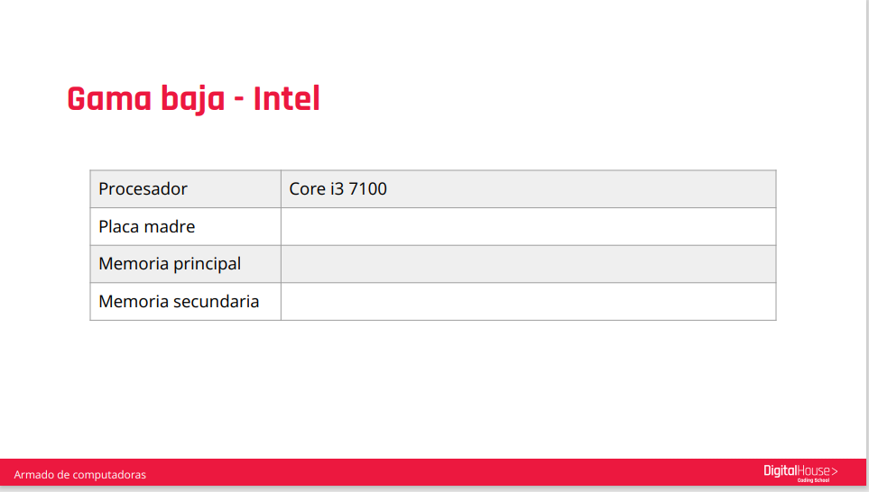
ASRock B150 Combo | Chipset: B150 Formato: ATX
Crucial 8GB DDR3L-1600 UDIMM
SSD interna Crucial MX500 1 TB 3D NAND SATA 2,5 pulgadas 7 mm (con adaptador de 9,5 mm)

Slide 2
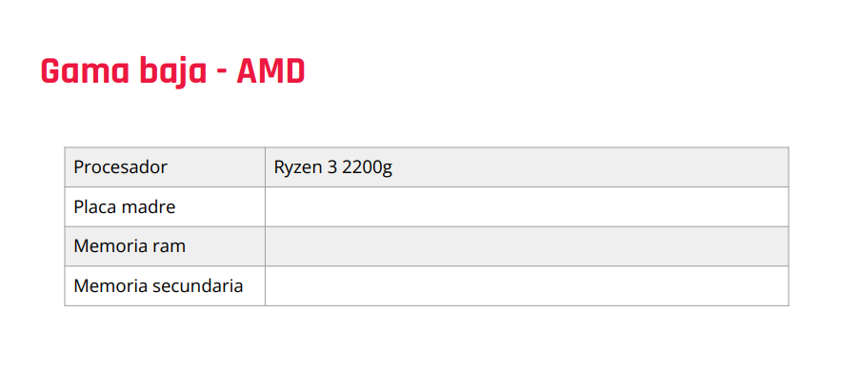
Asus prime B450M-A II
Crucial 8GB DDR4-2666 UDIMM
SSD Crucial P5 Plus 1 TB PCIe M.2 2280SS

Slide 3
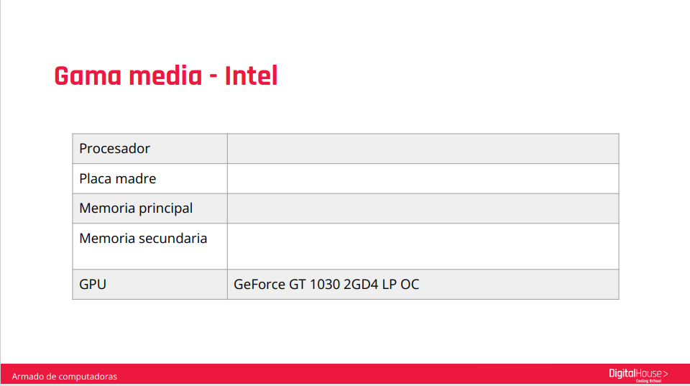
Intel I3 - 12300
ASRock B660 Pro RS
Crucial 16GB DDR4-2666 UDIMM
SSD Crucial P5 Plus 2 TB PCIe M.2 2280SS

Slide 4
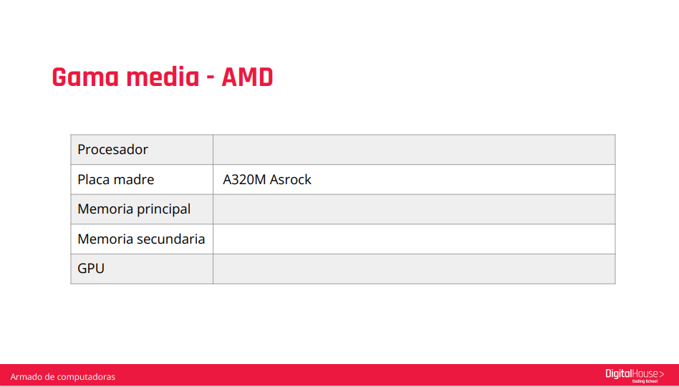
Procesador AMD RYZEN 5 3600 4.2GHz Turbo AM4 Wraith Stealth
Crucial 16GB DDR4-2666 UDIMM
SSD Crucial P5 Plus 2 TB PCIe M.2 2280SS
Placa de Video Asrock Radeon RX 6500 XT 4 Gaming D OC

Slide 5
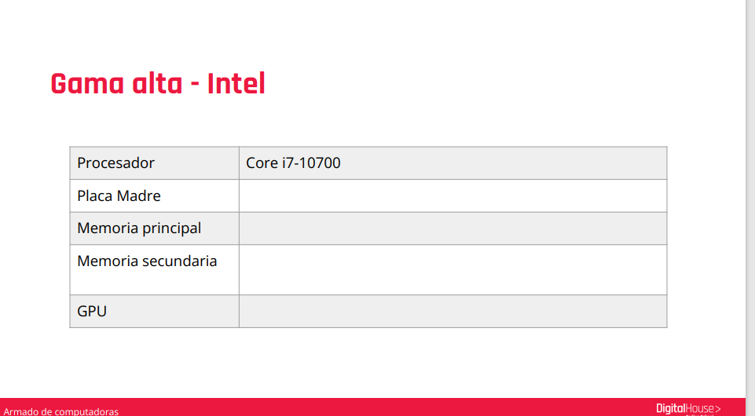
Mother Gigabyte B560 AORUS PRO AX S1200
Memoria Geil DDR5 32GB (2x16gb) 5200Mhz Polaris Red RGB CL34
Disco Rigido WD 12TB Gold 7.2K RPM 256MB
Placa de Video MSI GeForce GTX 1660 SUPER 6GB GDDR6 Ventus XS OC

Slide 6

Mother Asrock B550M Steel Legend AM4
Memoria Geil DDR5 32GB (2x16gb) 5200Mhz Polaris Red RGB CL34
Disco Rígido Toshiba 8TB N300 NAS 7200rpm 256MB
Placa de Video Zotac GeForce GTX 1660 6GB GDDR5 Dual Fan

